Slide 1

SQL Project Challenge
Consumer Goods
Ad-hoc Insights
Atliq Hardwares
Notes:
1

Slide 2
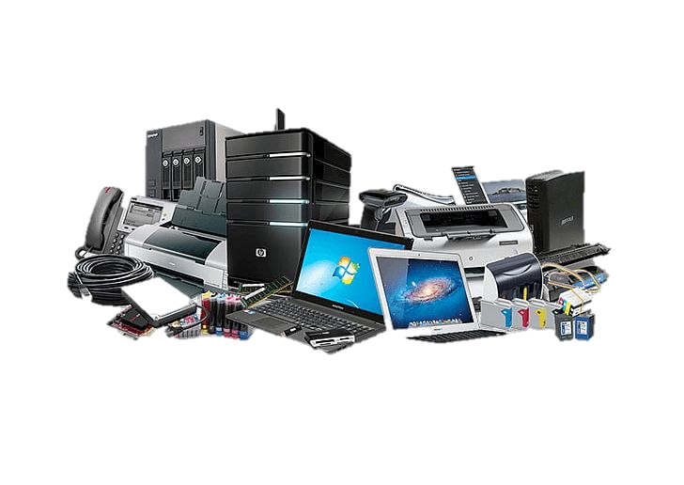




Background Study
EUROPEAN UNION
ASIA PACIFIC
NORTH AMERICA
LATIN AMERICA

Slide 3



Data Analytics Approach
Data Collection
Data Visualization
Collecting relevant data from the Data Engineers
Visualizing Data using PowerBI tool
Data Analysis
Data Story Telling
Analysing data
using MySQL
Driving insights as potential solutions, trends and grey space,
1
Notes:
3

Slide 4

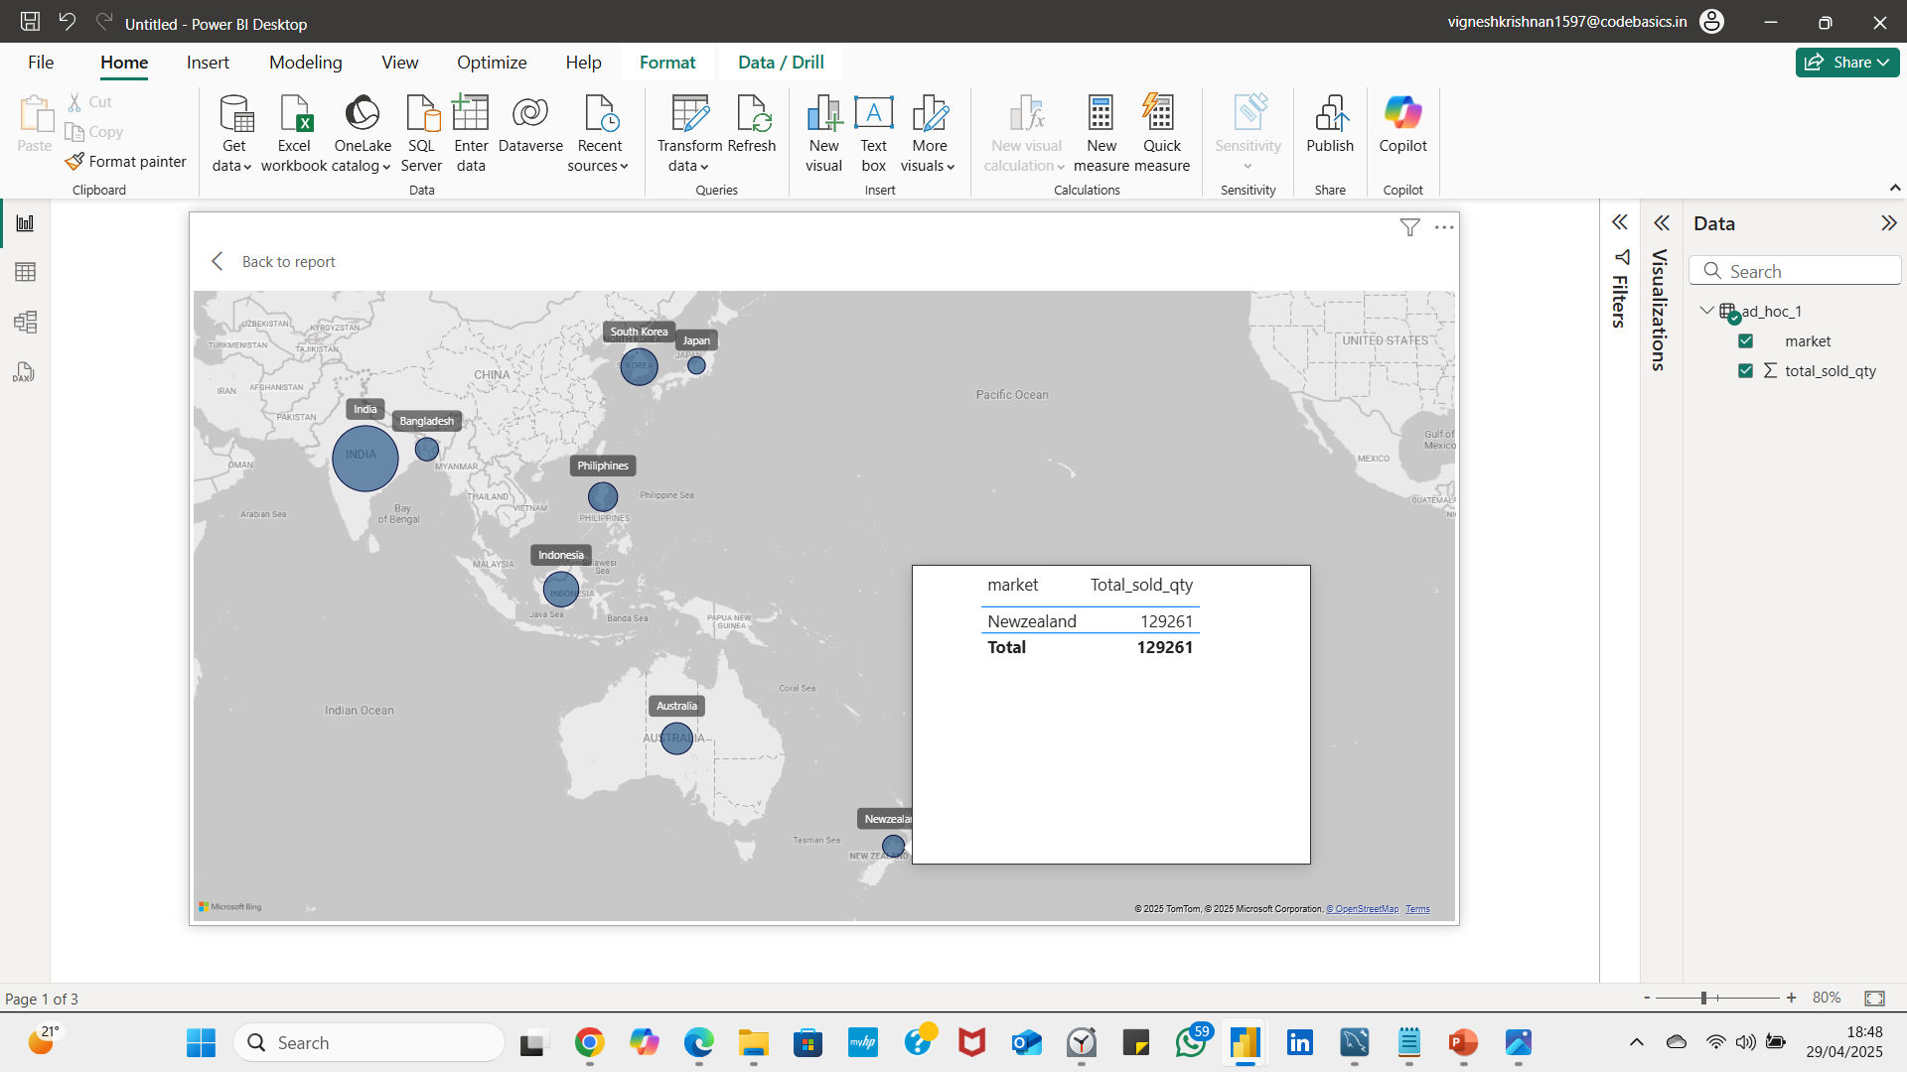
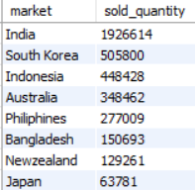
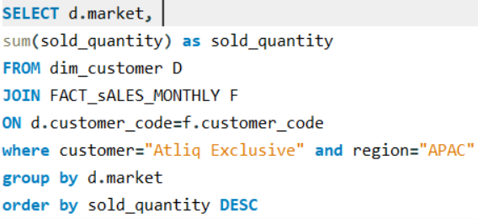
Provide the list of markets in which customer
"Atliq Exclusive" operates its business in the APAC region.
Key Insights
India, South Korea, and Indonesia are the top three markets where Atliq Exclusive conducts its operations in Asian region.

Slide 5

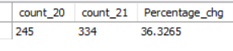
What is the percentage of unique product increase in 2021 vs. 2020?
Key Insights
Approximately 232 products are common between 2020 and 2021.
In 2021, 102 new products are introduced.
New products launched in 2021 exhibited significant market potential. When their total order quantity is tripled, it equals the total order quantity of common products—highlighting strong demand and growth opportunities

Slide 6


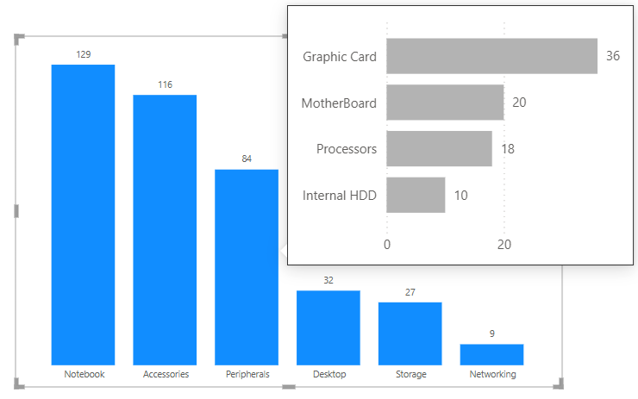
Provide a report with all the unique product counts for each segment
💻
Notebooks(personal laptops), Accessories (mouse, keyboards) and Peripherals are the top 3 categories by product count.
Notebook products (personal, business, and gaming laptops) have the lowest sold quantity
Despite low units sold, notebook products rank highest in gross sales due to higher unit prices
It is recommended that Atliq hardware shall focus its innovation on these high-performing segments to address existing pain points and capitalize on market demand.
🖱️
⌨️
Notes:
6

Slide 7
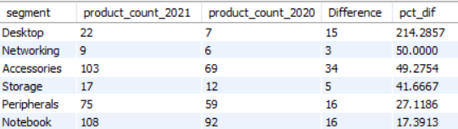
Which segment had the most increase in unique products in
2021 vs 2020?
Key Insights
Atliq Hardware has introduced numerous innovations in the accessories segment, with steady product development also seen in the peripherals and notebook categories.
Meanwhile, a significant increase in total product count was observed in the desktop segment, driven by the introduction of new personal and business desktops in 2021.

Slide 8
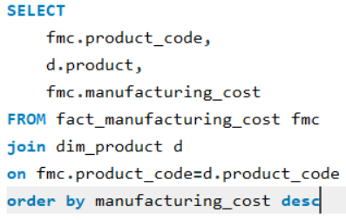
Get the products that have the highest and lowest manufacturing costs
AQ HOME Allin1 Gen 2
AQ Master wired x1 Ms
$240.53
$0.892
Highest Manufacturing cost
Lowest Manufacturing cost
💻
🖱️
Notes:
8

Slide 9

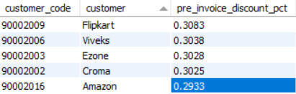

Slide 10
Generate a report which contains the top 5 customers who received an average pre_invoice_discount_pct for the fiscal year 2021 and in the Indian market.
Key Insights
Pre-invoice discounts were consistently offered to all five customers in the Indian market during 2021. Among them, Flipkart received the highest discount rate, with Atliq Hardware allotting a 30.83% discount.
Notes:
9

Slide 10
Get the complete report of the Gross sales amount for the customer “Atliq Exclusive” for each month
Key Insights
Atliq Exclusive recorded its highest sales in November 2020 at 20.46 million, while the lowest occurred in March 2020—largely due to the impact of the COVID-19 outbreak.
Business operations were disrupted early in the year 2020, with gradual recovery beginning after September 2020 as market conditions stabilized.
Notes:
10

Slide 11
In which quarter of 2020, got the maximum total sold quantity?
Key Insights
Q3 records minimum sales volume
Q1 records maximum sales volume
In FY 2020, the total sold quantity is 20.78 million units, while FY 2021 recorded a significant increase to 50.16 million units.
Q1 of FY 2021 witnessed the highest sales across all segments, including accessories, storage, peripherals, networking, notebooks, and desktops.
The sold quantity in Q1 of FY 2021 was nearly double that of Q1 in FY 2020.
The data clearly indicates that the notebooks segment contributed to sales only in FY 2021, with no sales recorded in FY 2020.
Q1 – September, October, Nov 2019
Q2- December, January, February 2020
Q3- March, April, May 2020
Q4 – June, July, August 2020
Q1 – September, October, Nov 2020
Q2- December, January, February 2021
Q3- March, April, May 2021
Q4 – June, July, August 2021
Note: Sold quantity values are in millions
Notes:
11

Slide 12
Which channel helped to bring more gross sales in the fiscal year 2021
and the percentage of contribution?
2021
2020
73% Retailer | 15% Direct | 11% Distributer
70% Retailer | 18% Direct | 11% Distributer
Key Insights
Retailers such as Amazon, Flipkart, Ebay contributed maximum gross sales of 73% followed by direct and distributer channels.
Decline in direct channel is observed in the fiscal year 2021 compared to fiscal year 2020.
Distributers such as Leader, Sage, Neptune, Novus and Synthetic followed to contribute gross sales in consistent manner.
Notes:
12

Slide 13
Get the Top 3 products in each division that have a high
total sold quantity in the fiscal year 2021?
Key Insights
In the Network & Storage divisions, the top three products are predominantly pen drive variants.
The Peripherals & Accessories category is primarily occupied by mouse variants, while the Notebook & Desktop segment is led by personal laptops.
Notes:
13

Slide 14
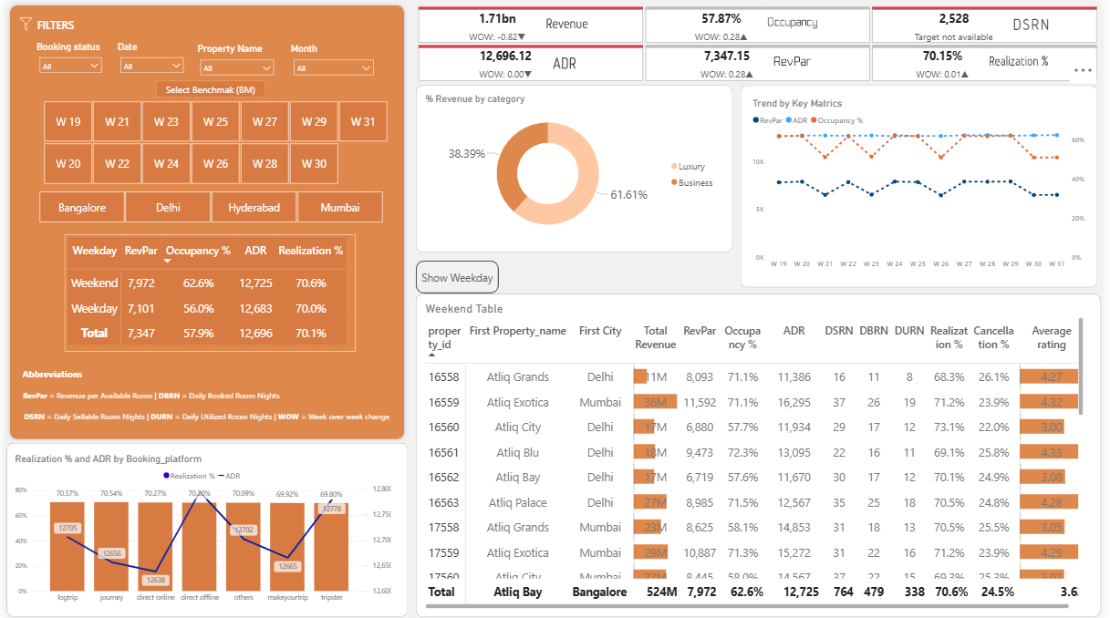
Hospitality Domain

Slide 15
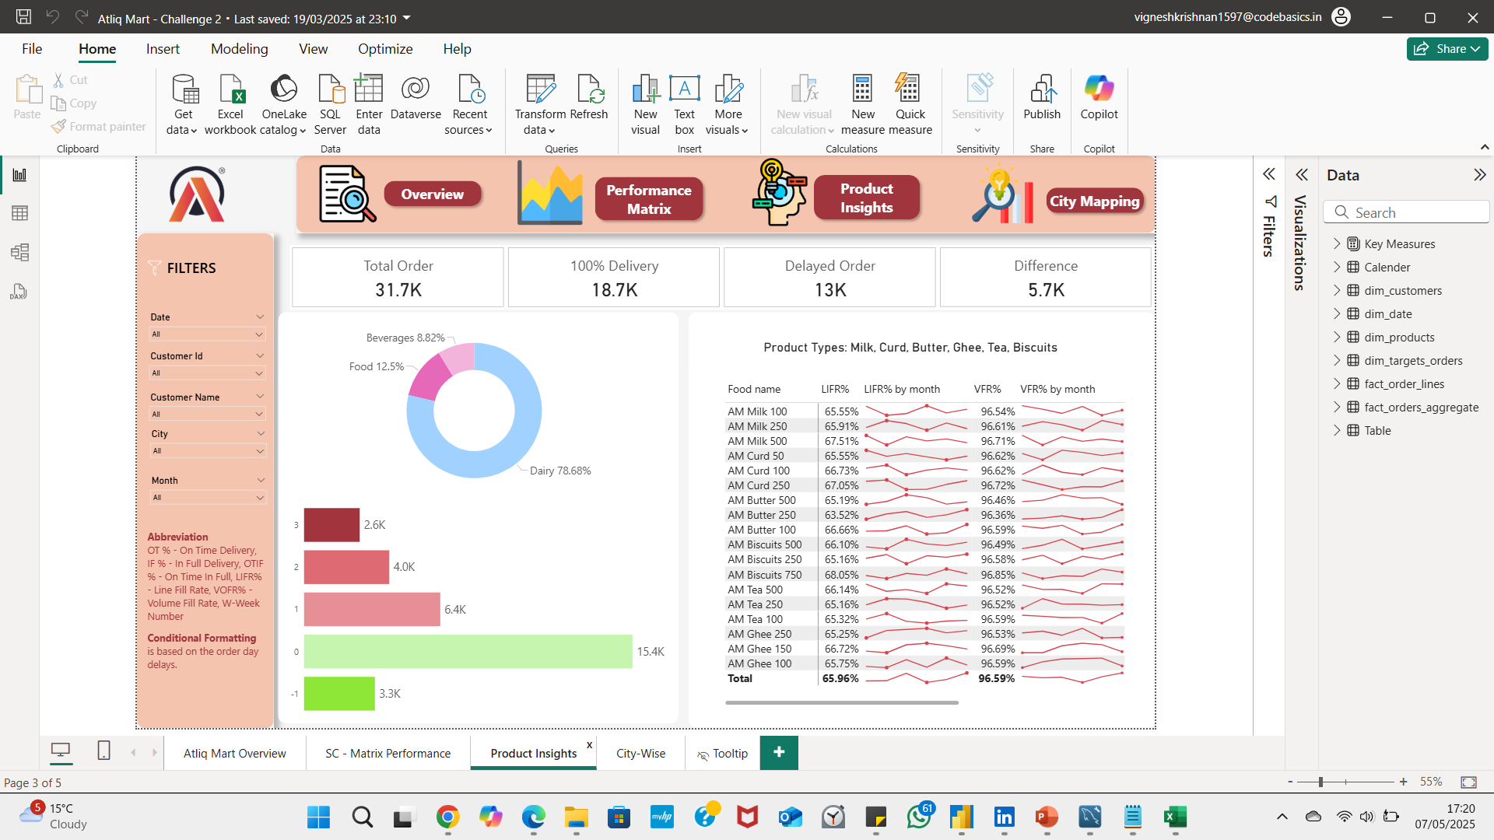
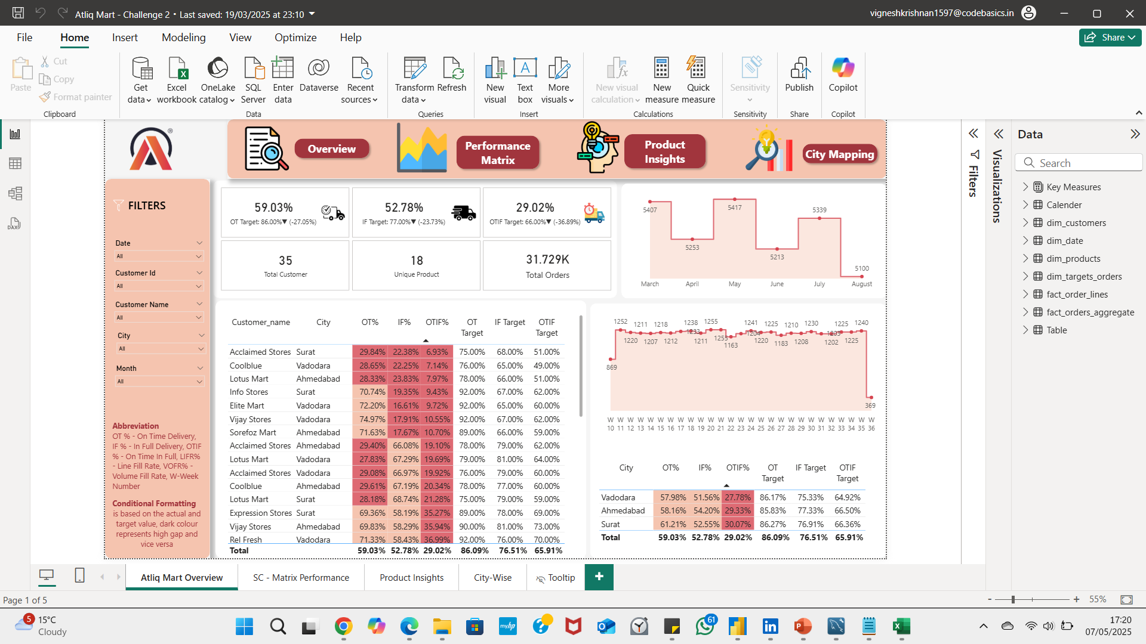
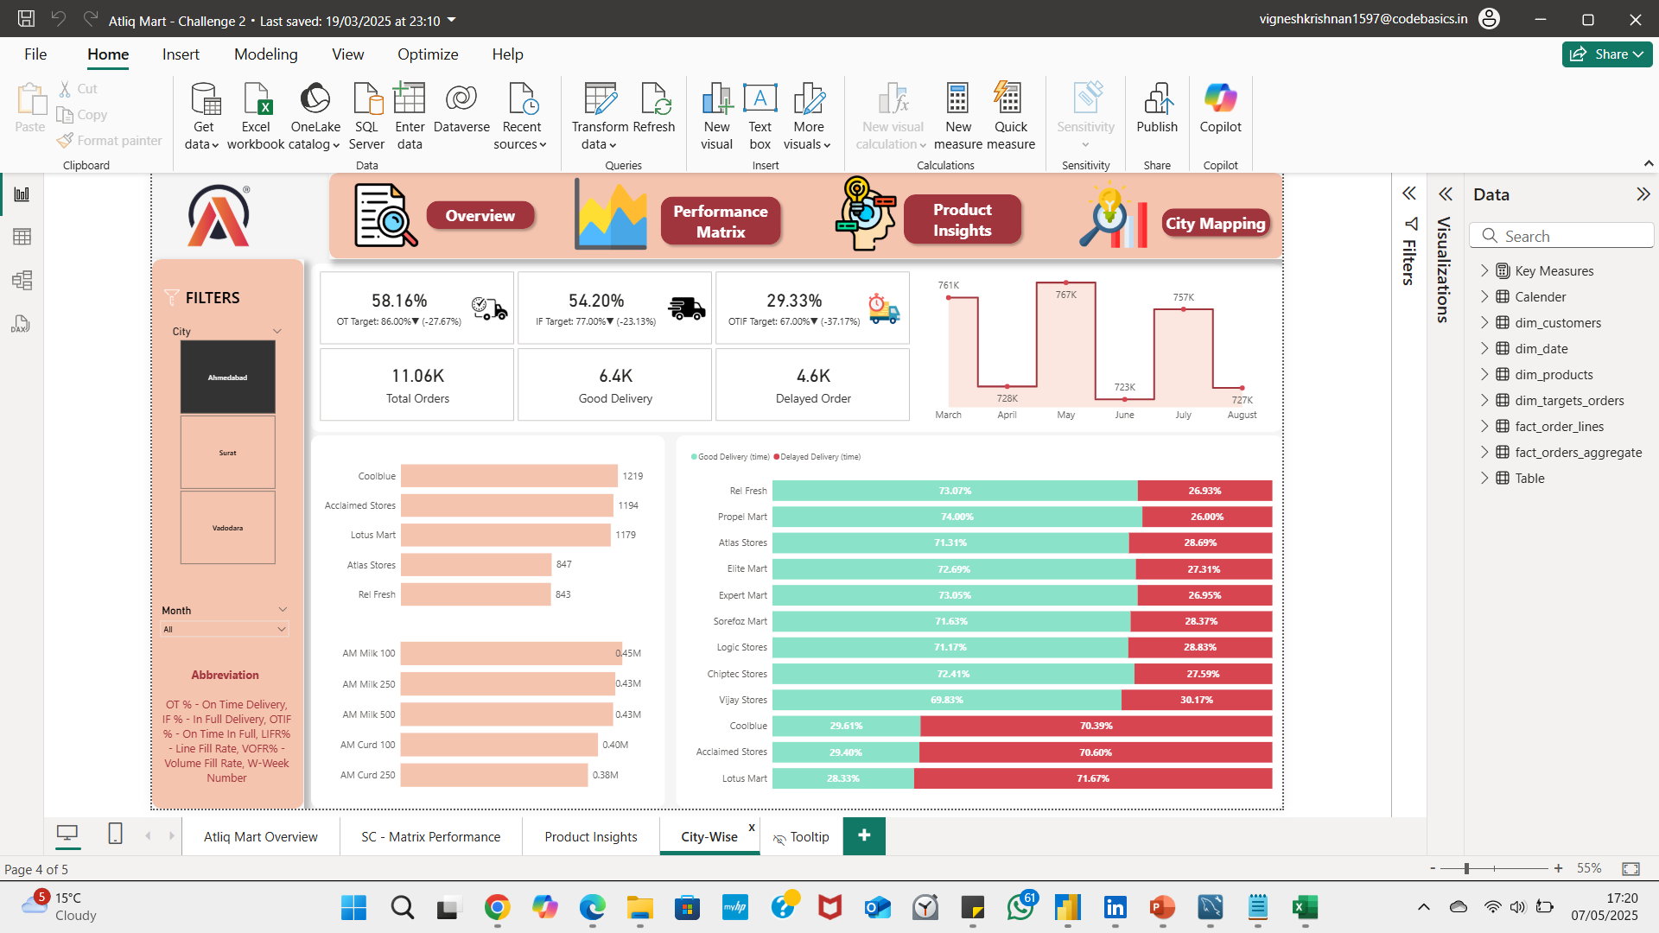
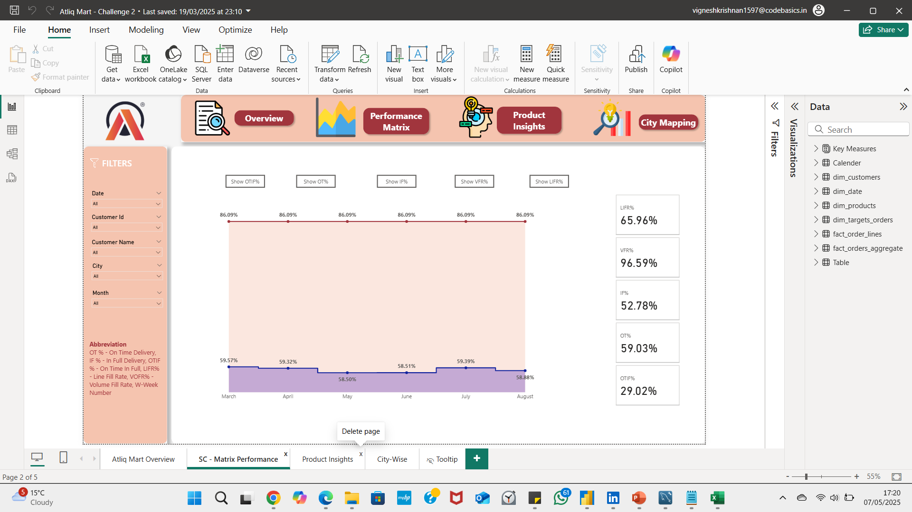
Supply Chain Domain

Slide 16

THANK YOU
Notes:
16

